Slide 1
M12

Slide 2

Vaccination
As a general principle, we can ‘fool’ the immune system into developing a memory for a particular infection by putting something, that mimics the microbe we want to vaccinate against, into the body.
This does not actually cause the disease but this would prevent any subsequent exposure to the infecting microbe from turning into actual disease.
Many such vaccines are now available for preventing a whole range of infectious diseases, and provide a disease-specific means of prevention.
Most vaccines contain a little bit of a disease germ that is weak or dead. Vaccines do NOT contain the type of germ that makes you sick. Some vaccines do not contain any germs.
Having this little bit of the germ inside your body makes your body's defence system build antibodies to fight off this kind of germ. Antibodies help trap and kill germs that could lead to disease.

Slide 3
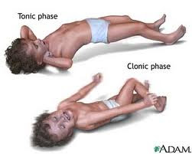
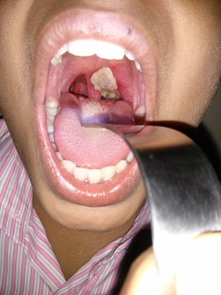
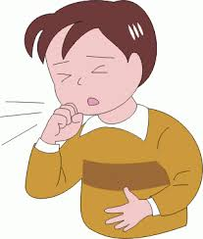
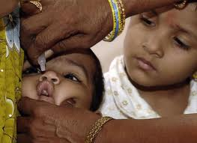
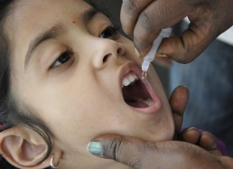
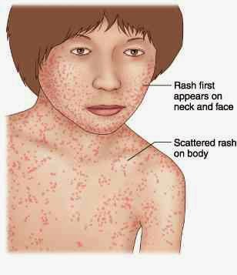
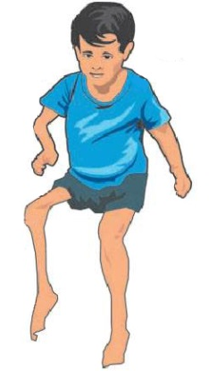
Vaccination
There are vaccines against tetanus, diphtheria, whooping cough, measles, polio and many others.
These form the public health programme of childhood immunisation for preventing infectious diseases.

